Slide 1
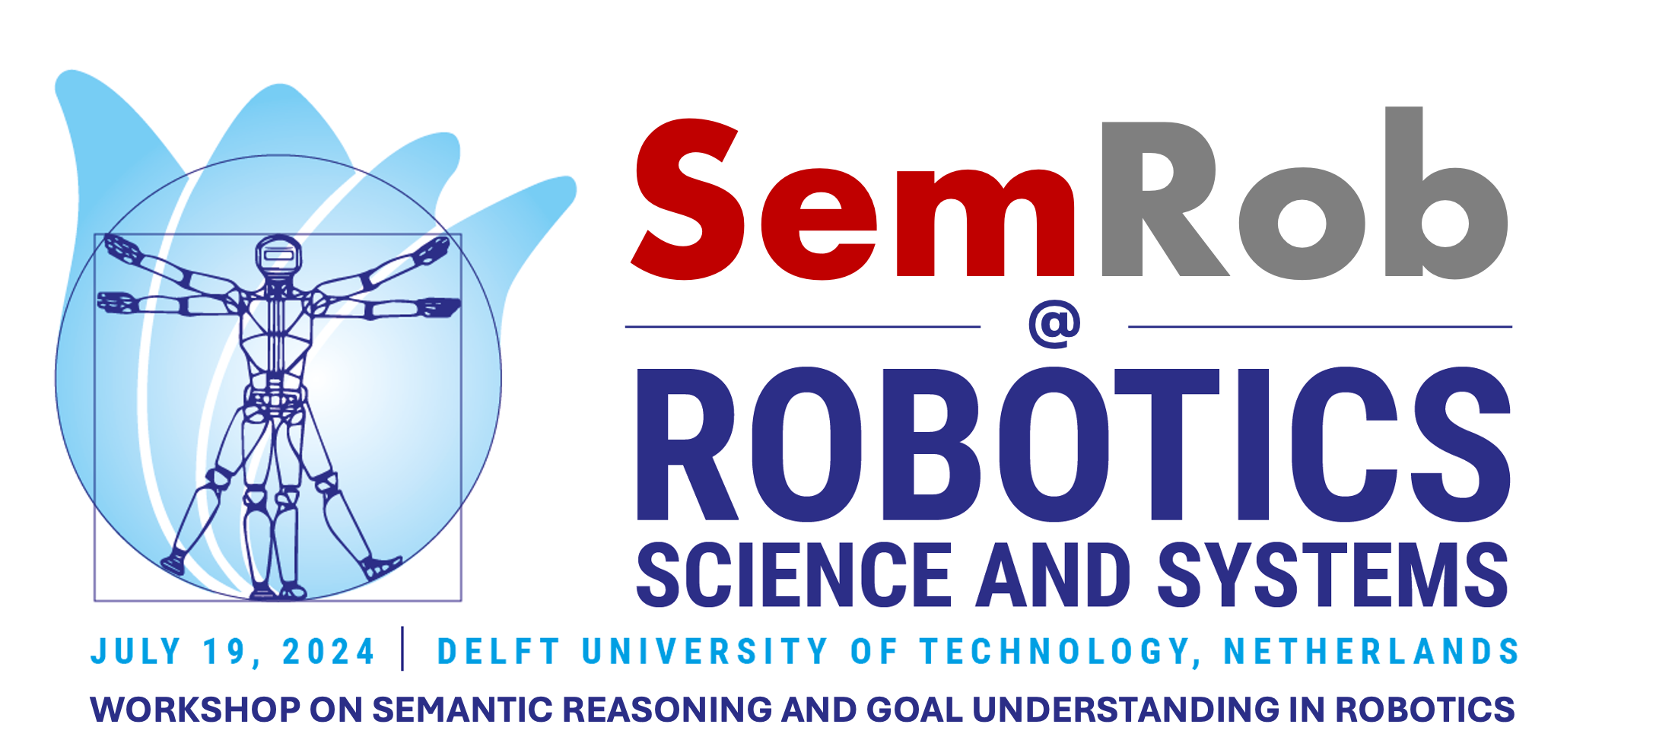

Slide 2
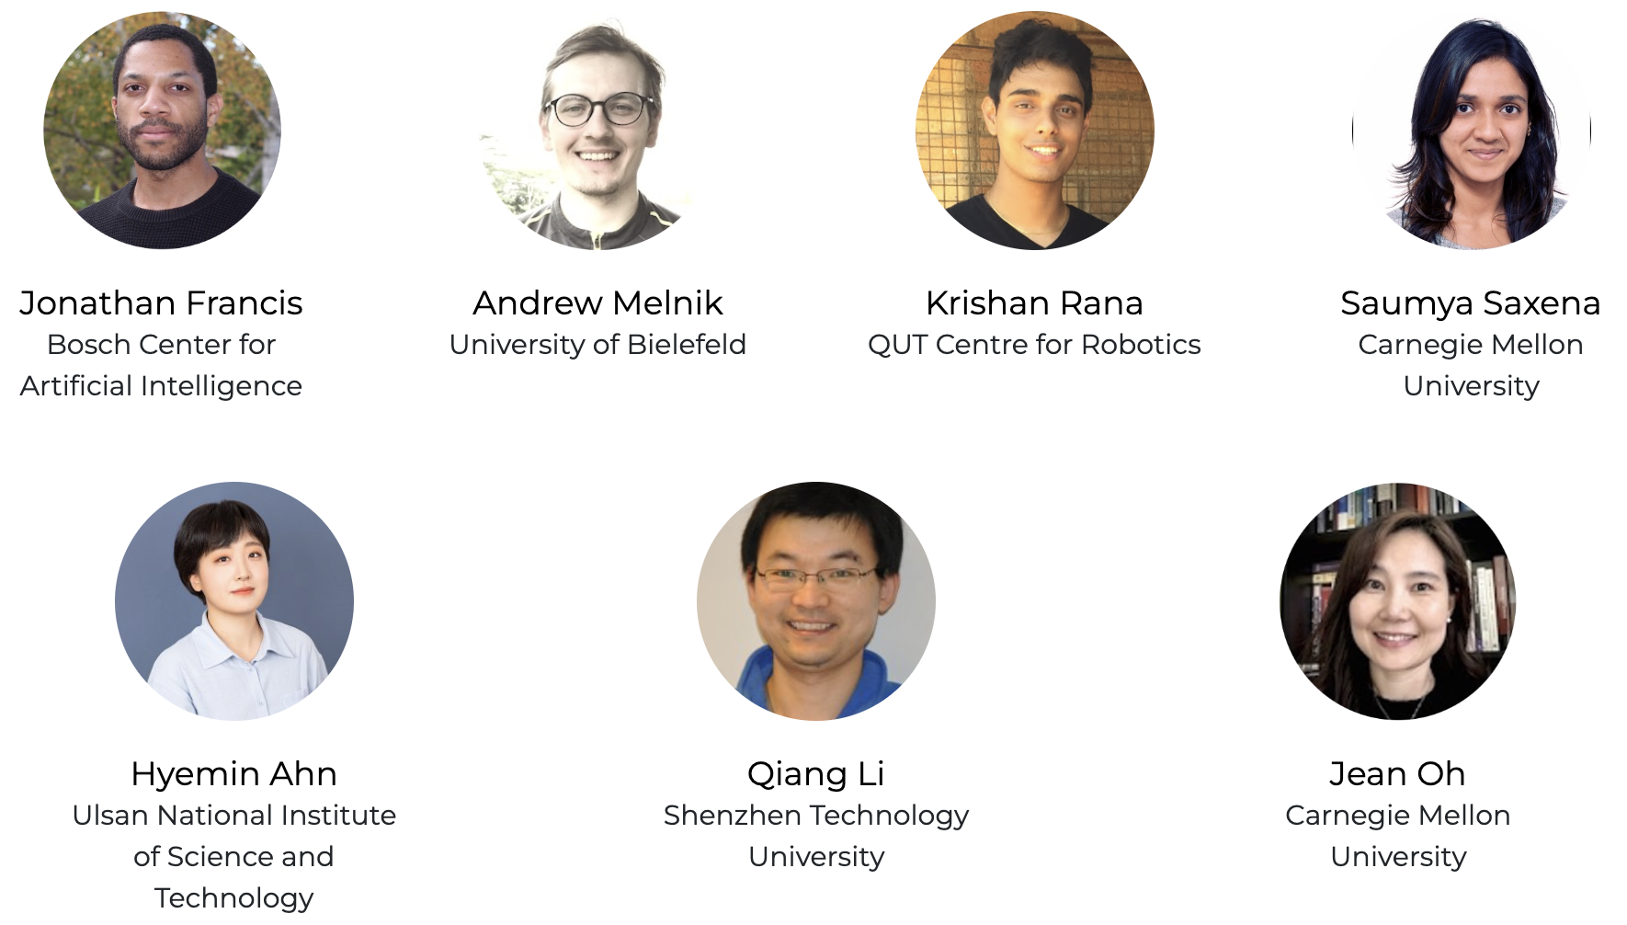
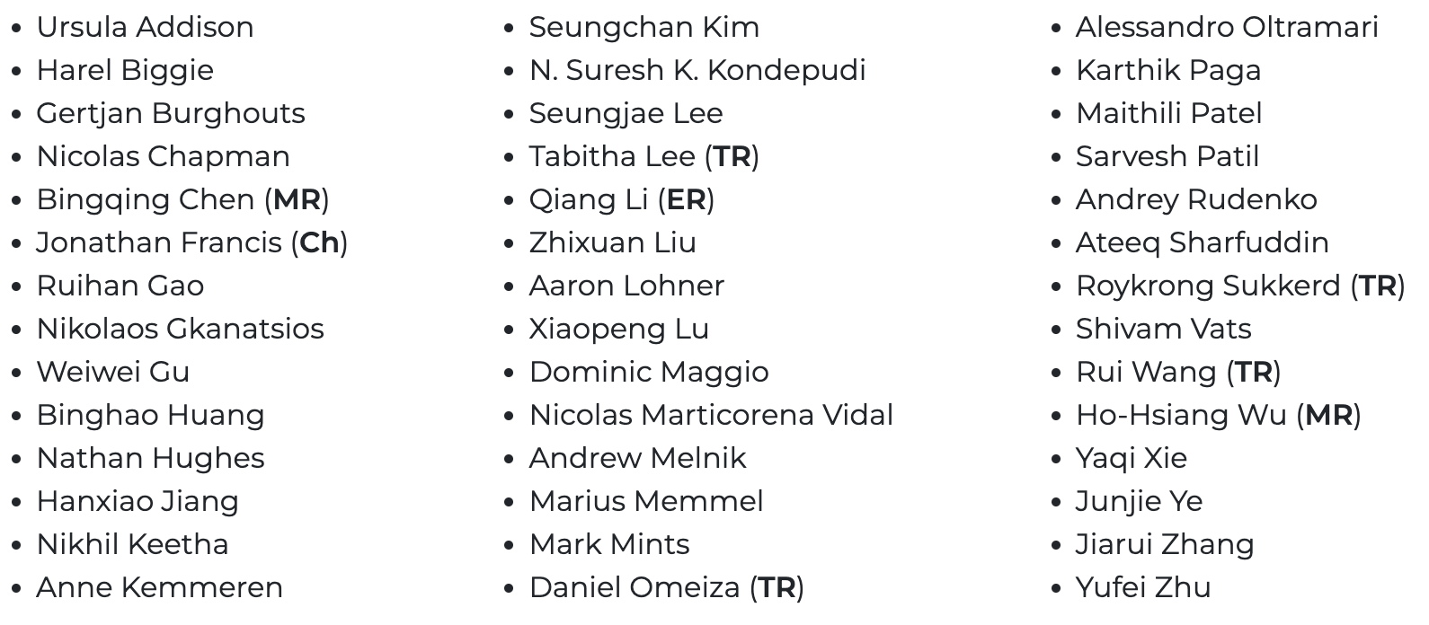
Committees
Organising Committee
Programme Committee
ER — Recognises PC member who served as an Emergency Reviewer.
TR — Recognises PC member who ranked in the top 10% of all Reviewers.
MR — Recognises PC member who provided their services as a Meta-Reviewer.
Ch — Paper Track Chair.

Slide 3
Overview
We emphasize methods that combine foundation models representations with mechanisms that may prove useful for semantic reasoning and abstract goal understanding, e.g., neural memory mechanisms, procedural modules (e.g., cognitive architectures), neuro-symbolic representations (e.g., knowledge/scene graph embeddings), chain-of-thought reasoning mechanisms, robot skill primitives and their composition, world model representations, etc.
We unite engineers, researchers, and practitioners from different communities to enable interdisciplinary research on methods that facilitate deployment of semantics-aware and generalizable embodied agents in unstructured and dynamic real world environments. Our organizers, presenters, panelists, and TPC are drawn from: Robot Learning, Embodied AI, Planning + Controls, Cognitive Robotics, Neuro-Symbolism, Natural Language Processing, Computer Vision, and Multimodal Machine Learning.

Slide 4
Research Questions
What are the most effective representations and reasoning mechanisms for semantic understanding in Robotics?
Should vision and language remain the primary grounding bases for robot-centric state representations?
What are the best ways to combine explicit and implicit scene context representations, for robot decision-making and control in real-world settings?
How to leverage computationally-expensive resources (e.g., foundation models) for inference on resource-constrained robotics platforms?
How to ensure safe decision-making while using pre-trained multimodal foundation models in novel and dynamic environments?

Slide 5
Workshop Topics
Methods for learning semantically-rich and generalizable state representations
Methods for learning general goal representations, e.g., in instruction-following
Reasoning mechanisms for generalization in open-vocabulary contexts, focused on real-world deployment
Planning with chain-of-thought mechanisms and reasoning about failures
Novel neural architectures exploring multimodal prompt mechanisms
Efforts to leverage foundation models for robotics tasks; efforts to create robotics foundation models
Methods for grounding distilled foundation model representations with additional modalities (e.g., haptics, audio, IMU signals, joint torques, etc.)
Paradigms for data-efficient concept learning, e.g., learning generalizable skills from few-shot demonstrations, interactive perception, co-simulation, etc.

Slide 6
Paper Track
Strong paper track, with 20 accepted papers
Topics including: leveraging RFMs for manipulation/grasping, affordance reasoning, scene graph generation, open-vocabulary mobile manipulation, transfer representation learning for robotics, and many more
20 posters, 4 of which were selected as spotlights
(#2) la VIDA: Towards a Motivated Goal Reasoning Agent
(#3) Open6DOR: Benchmarking Open-instruction 6-DoF Object Rearrangement and A VLM-based Approach
(#4) SAGE: Bridging Semantic and Actionable Parts for Generalizable Manipulation of Articulated Objects (spotlight)
(#5) Behavior Generation with Latent Actions (spotlight)
(#6) Language models are robotic planners: reframing plans as goal refinement graphs
(#7) OK-Robot: What Really Matters in Integrating Open-Knowledge Models for Robotics
(#9) Clio: Real-time Task-Driven Open-Set 3D Scene Graphs
(#10) Opening Cabinets and Drawers in the Real World using a Commodity Mobile Manipulator
(#12) VLA-3D: A Dataset for 3D Semantic Scene Understanding and Navigation
(#14) Enhancing Vision-Language Models with Scene Graphs for Traffic Accident Understanding
(#15) Which objects help me to act effectively? Reasoning about physically-grounded affordances
(#17) RAM: Retrieval-Based Affordance Transfer for Generalizable Zero-Shot Robotic Manipulation
(#19) Dialog-based Skill and Task Learning for Robot
(#20) Embodied AI Robot Companion for Efficient Object Handling in Bimanual Teleoperation
(#21) Grounding Language Plans in Demonstrations Through Counterfactual Perturbations
(#22) RoboEXP: Action-Conditioned Scene Graph via Interactive Exploration for Robotic Manipulation
(#23) Lang2LTL-2: Grounding Spatiotemporal Navigation Commands Using Large Language and Vision-Language Models
(#24) CogExplore: Contextual Exploration with Language Encoded Environment Representations
(#26) Language-Grounded Dynamic Scene Graphs for Interactive Object Search with Mobile Manipulation (spotlight)
(#27) Natural Language Can Help Bridge the Sim2Real Gap (spotlight)

Slide 7
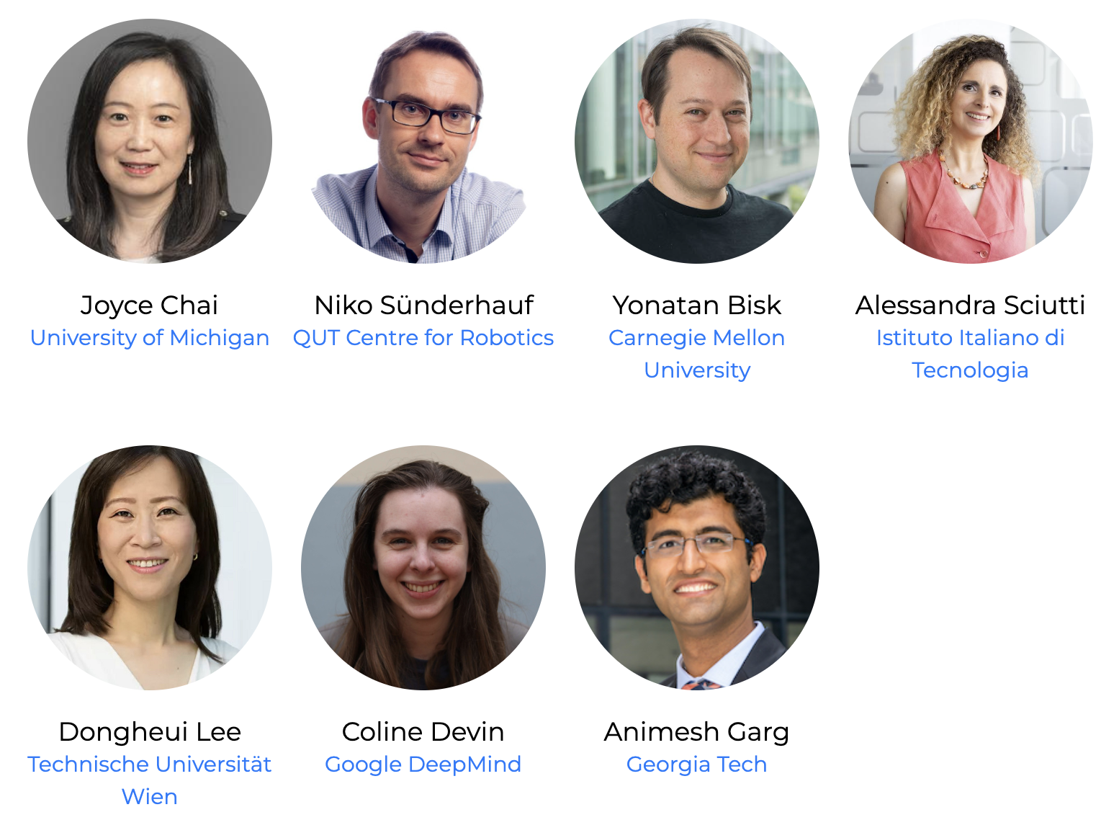
Speakers & Panelists

Slide 8
Components
5 invited speakers
4 oral spotlight talks
20 poster presentations
~1 hour poster session
~1 hour debate panel

Slide 10
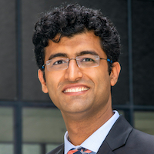
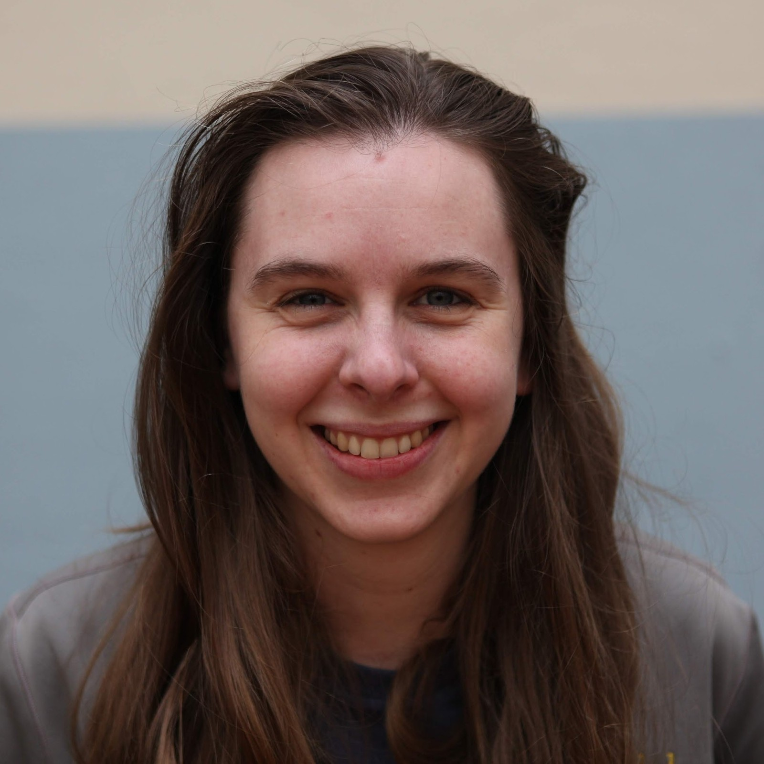
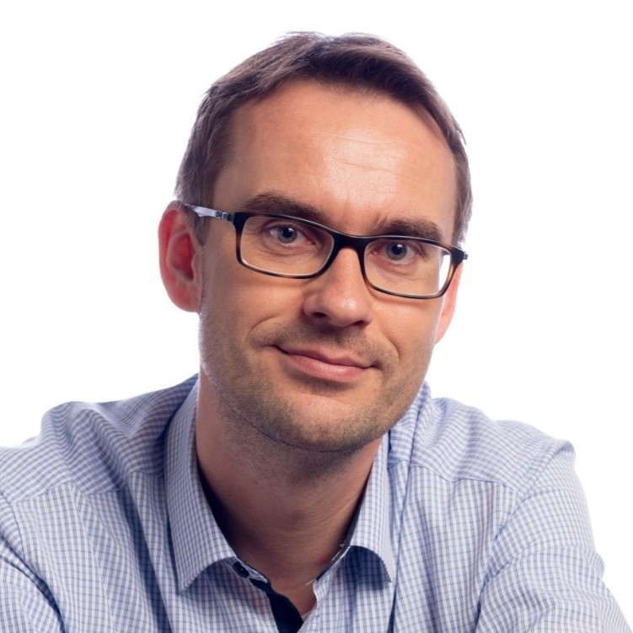
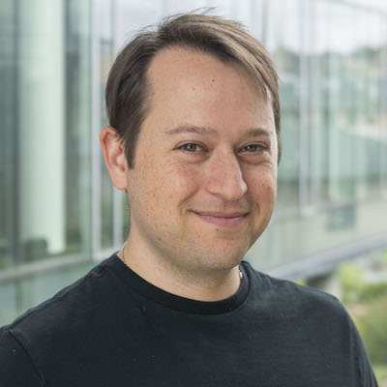

Debate Panel
Animesh Garg
Assistant Professor
Georgia Tech
Coline Devin
Senior Research Scientist
Deepmind
Niko Sünderhauf
Professor
QUT Centre for Robotics
Yonatan Bisk
Assistant Professor
Carnegie Mellon University
Slido — submit your questions! https://app.sli.do/event/2YZ5kgotSaPWcEEgSiYS6H

Slide 12
Best Paper Selection
20 paper accepted for poster presentation at RSS SemRob 2024
Paper Track Chair(s) selected the four highest-ranking papers as Oral Spotlights, according to reviewer scores
Chairs confirmed paper and reviewer efficacy
Chairs compared and ranked top-4 works, double-blind
Paper Track Chair(s) selected highest ranking paper as Best Paper

Slide 13
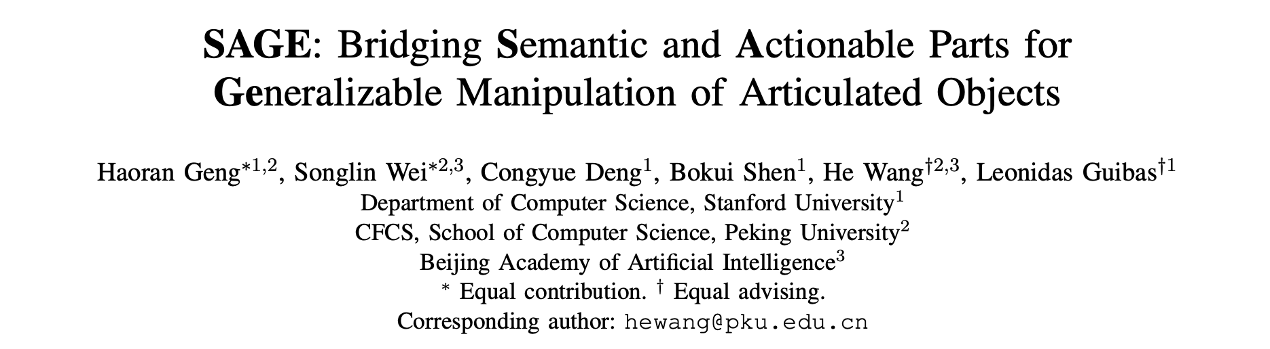
Best Paper Award 🎉
Presented by Haoran Geng (Stanford + Peking)

Slide 15

Thank you!
Dr. Jonathan Francis (Bosch Center for AI + CMU)
Dr. Andrew Melnik (Bielefeld)
Dr. Krishan Rana (QUT)
Saumya Saxena (CMU)
Prof. Hyemin Ahn (UNIIST)
Prof. Qiang Li (SZTU)
Prof. Jean Oh (CMU)
jon.francis@us.bosch.com
andrew.melnik@uni-bielefeld.de
k.rana@qut.edu.au
saumyas@cs.cmu.edu
hyemin.ahn@unist.ac.kr
liqiang1@sztu.edu.cn
jeanoh@cmu.edu
Website: paper PDFs, presentation slides, videos, etc.

